Slide 1
K-Means Parallel Project
Massive DyNamic:
Liron Mizrahi, Daniel da Silva, Fran-pierre Nel and Jason Chalom

Slide 2
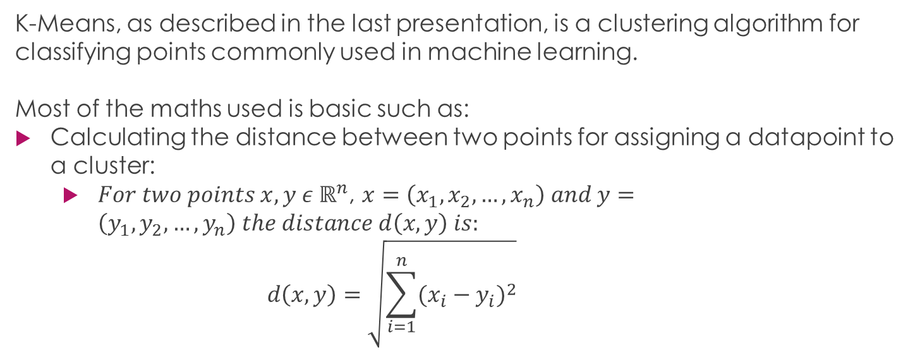
Maths Behind K-Means

Slide 3
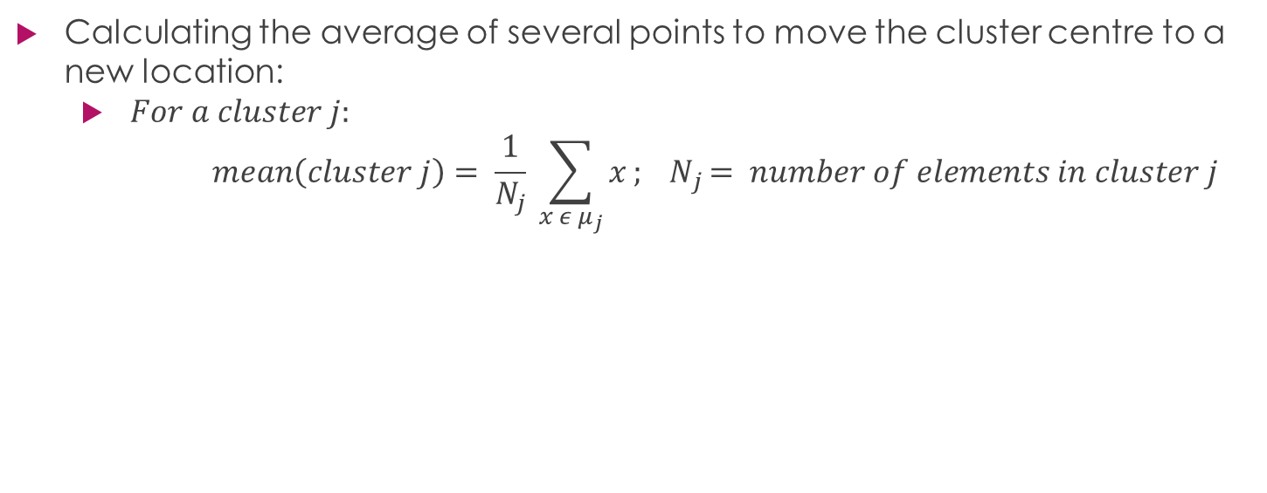
Maths Behind K-Means

Slide 4
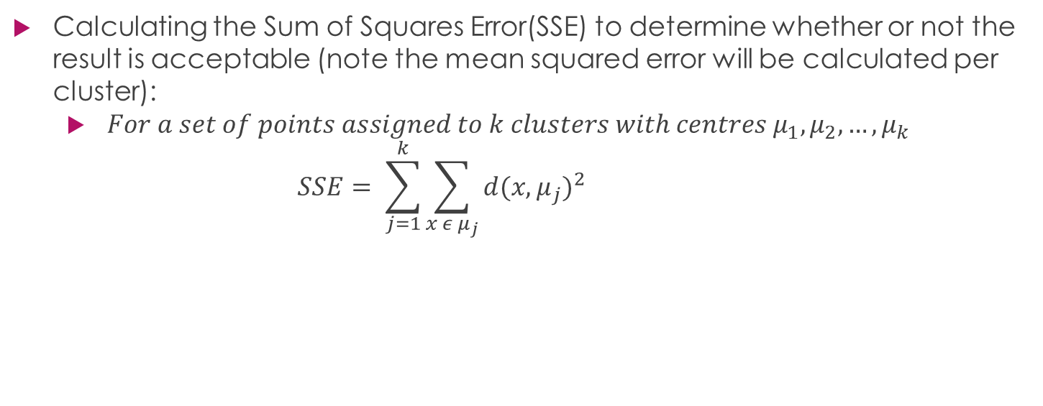
Maths Behind K-Means

Slide 5
Data Decomposition

Slide 6
Task Dependency

Slide 7
Task Decomposition

